Slide 1


PUBLIC SCHOOL RANKING SYSTEM

Slide 2
INTRODUCTION

Slide 3

WHAT IS IT ABOUT
The purpose of the project is to implement two innovative systems that would provide computer-based processes, namely Moodle and OMR, that will help individuals access data, view analytical graphs regarding the educational competency of public schools in the Philippines.
Notes:
After the content --- All of these will be viewable in a dashboard, based on their level of authority.

Slide 4

SCOPE AND LIMITATION
The system will be used by the students, faculty, guidance, principal, district office, division office, and regional office of public schools in order to track students’ and schools’ performance in the field of education.
Notes:
After the content -- However, the system shall not be used to compare and rank data based on the Students’ Quarterly Assessment Exam Results.

Slide 5



PURPOSE OF PROJECT MANAGEMENT
STAY ON TARGET
STAY ON BUDGET
STAY ON
TIME

Slide 6

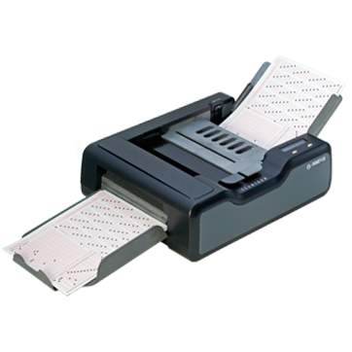
DATA GATHERING
There are two ways to get the data which is the exam results of students. These are the following:
Moodle
OMR Scanner
Notes:
Moodle - The system allows the administration of online tests with a variety of questions. The result of the exam reflects in the database. These will then be imported to the ranking system database. OMR - The flow of the system is the answer sheets shall be collected from the students. It will then go through scanning using an ADF scanner. An OMR processing that records each data will provide result displaying that will be ready for exporting.

Slide 7
GOALS & OBJECTIVES OF THE SYSTEM
GOALS | DESCRIPTION | OBJECTIVES
Administer Moodle based Quarterly Exams | Provide a Moodle system to ease the administering of the exams Provide functions to increase the quality of security of the exam data | To centralize the Quarterly Exams in all regions in the Philippines by implementing a management system called Moodle.
Administer OMR based Quarterly Exams | To produce an accurate data of the exams with minimal error quotient. To efficiently record the results of the exams. Highly reliable with minimize cost | To automate the process by providing speed, reliability, and ease of use against the manual import method.
Manage Data | Extraction of Results Application of analytics to the Quarterly Examination Results | To provide insights from the exam result to the extent of improving the performance of the specific users.
Centralize System | System integration between Ranking System and Moodle System Provide user access level | To optimally manage the users’ data depending on the user access restriction.

